Slide 1



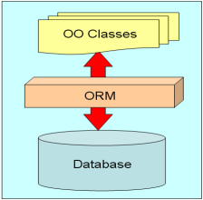

Database Applications
Database Apps Course Program, Evaluation, Exams
Database
Applications
SoftUni Team
Technical Trainers
Software University
http://softuni.bg

Slide 2



Table of Contents
Course Objectives
Course Program
Trainers Team
Examination
Learning Resources

Slide 3









SoftUni Diamond Partners

Slide 4

SoftUni: Levels, Modules, Schedule
Programming Basics
2 months
6 credits
Programming Fundamentals
36 credits
6 months
Advanced C#
Object-Oriented Programming
High-Quality Code
Java Basics
Teamwork and Personal Skills
Web Front-End
Back-End
36 credits
36 credits
HTML + CSS + WordPress
JavaScript Basics
Advanced JavaScript
Databases
Database Applications
Web Services and Cloud
6 months
JavaScript Applications
JavaScript Frameworks
PHP Web Development
ASP.NET MVC Web Development

Slide 5

Database Applications
Course Objectives & Program

Slide 6


Database Apps – Course Program
Course Introduction
ORM Technologies and Entity Framework (EF)
"Code First" Model in Entity Framework
Performance in Entity Framework
Data Access with ADO.NET
Transactions with EF
XML Basics and XML Parsers
Processing JSON

Slide 7



Database Apps – Course Program (2)
Working with MongoDb and Redis
Lab: Creating DB Application
Exam Preparation
Teamwork Defense
Practical Exam
Seminar – PHP Doctrine ORM
Seminar – Java Hibernate ORM

Slide 8

The Trainers Team

Slide 9


Trainers Team
Atanas Rusenov
Technical Trainer @ Software University
Top performing student from the Software University (2014)
Nikolay Bankin
Software Engineer at Obecto
Top performing student from the Software University (2014)

Slide 10

Database Applications: More Details
Duration, Languages, Technologies

Slide 11


Training Duration – Database Applications
Lectures: ~ 20 hours (onsite + YouTube videos)
Practical exercises (in class): ~ 15 hours
Homework: ~ 20-30 hours
Teamwork project: ~ 10-20 hours
Schedule: July 2015
Practical exam: 2 Aug 2015

Slide 12



Why English?
Why the slides are in English?
English is the native language of the software engineers
Specific terminology should be in English
Translations are inaccurate and funny
Just learn English!
No excuses

Slide 13



Database Applications
Evaluation Criteria

Slide 14

Scoring System for the "Database Apps"
Practical exam – 80%
Teamwork project – 10%
Homework + evaluation – 5% + 5%
Presence in class: 5% (onsite students only)
Bonuses: up to 10%

Slide 15

Database Applications – Practical Exam
The practical exam tests your skills to work with Entity Framework
Design data processing logic with Entity Framework
Map databases with Entity Framework
Code first / database first approaches
Perform CRUD operations
Import and export data to XML/json

Slide 16

Homework Assignments
Doing your homework is very important!
Programming can only be learned through a lot of practice!
You should write code every day!
Each lecture is followed by a few exercises
Try to solve them in class
The rest are your homework
Homework assignments are due in 1 week after each lecture
Submission will be accepted through our web site: softuni.bg

Slide 17

Homework Peer Reviews
Give feedback to a few random homework submissions
Students submit homework anonymously
Please exclude your name from the submissions!
For each homework submitted
Students evaluate 3 random homeworks
From the same topic, after the deadline
Give written feedback, at least 200 characters
Low-quality feedback → report for punishment
Everyone will get feedback for their homework

Slide 18








Resources
What We Need Additionally?

Slide 19

Course Web Site & Forums
The Database Applications official web site:
Register for the "Software University Forum":
Discuss the course exercises with your colleagues
Find solutions for all course exercises
Share source code / discuss ideas / help each other
https://softuni.bg/trainings/1169/Database-Applications-Jul-2015
https://softuni.bg/forum

Slide 20



Database Applications Slides and Videos
All lecture slides, videos, homework assignments, projects and other resources are open content, available for free
Visit the course web site to access the course resources

Slide 21

Database Applications – Additional Resources
Entity Framework Tutorial
http://www.entityframeworktutorial.net
Entity Framework Official Documentation
https://msdn.microsoft.com/en-us/data/ee712907

Slide 22
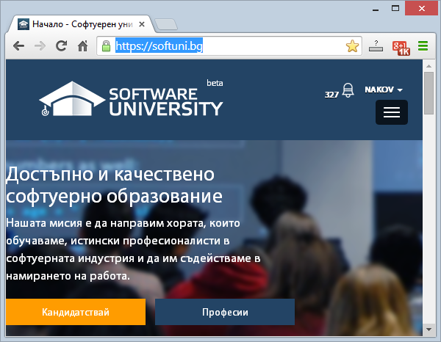
Software University Learning System (SULS)
Software University Learning System (SULS)
www.softuni.bg
Important resource for students
Homework submissions
Homework check-up
Exams and results
Reports about your progress
…

Slide 23
Recommended Software
Microsoft SQL Server 2014 (Express or Standard Edition) + SQL Server Management Studio 2014
SQL Server 2012 may work as well
MySQL 5.6 + MySQL Workbench 6
Oracle 11g XE (Express Edition) + Oracle SQL Developer 4.0
MongoDB 2.6 + Robomongo
SQLite + System.Data.SQLite.EF6
Visual Studio Community 2013

Slide 24




Database Applications – Course Introduction
https://softuni.bg/courses/database-applications/

Slide 25
License
This course (slides, examples, demos, videos, homework, etc.) is licensed under the "Creative Commons Attribution-NonCommercial-ShareAlike 4.0 International" license
Attribution: this work may contain portions from
"Databases" course by Telerik Academy under CC-BY-NC-SA license

Slide 26





Free Trainings @ Software University
Software University Foundation – softuni.org
Software University – High-Quality Education, Profession and Job for Software Developers
softuni.bg
Software University @ Facebook
facebook.com/SoftwareUniversity
Software University @ YouTube
youtube.com/SoftwareUniversity
Software University Forums – forum.softuni.bg

